Slide 1

Problems on Confidence Interval 2012

Slide 2
Reference
Data
Youtube
Code

Slide 3
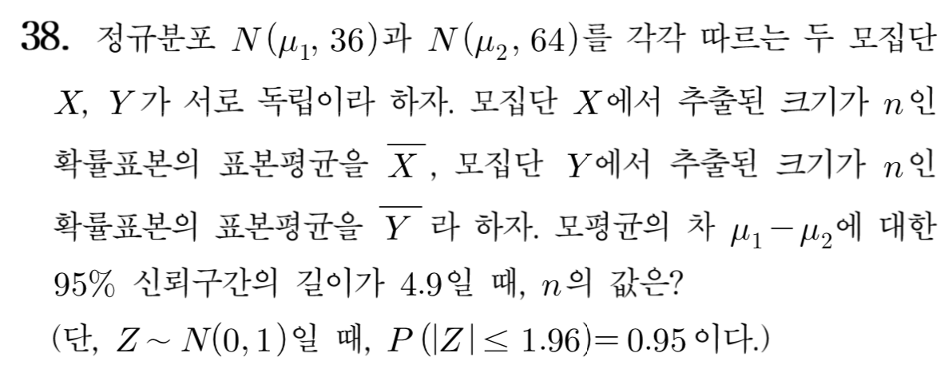
[2012]

Slide 4
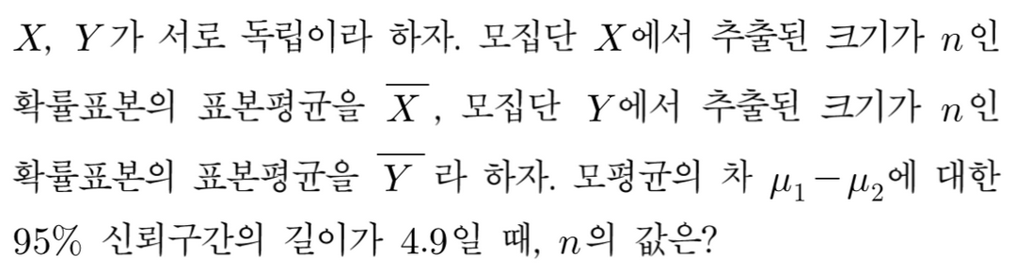

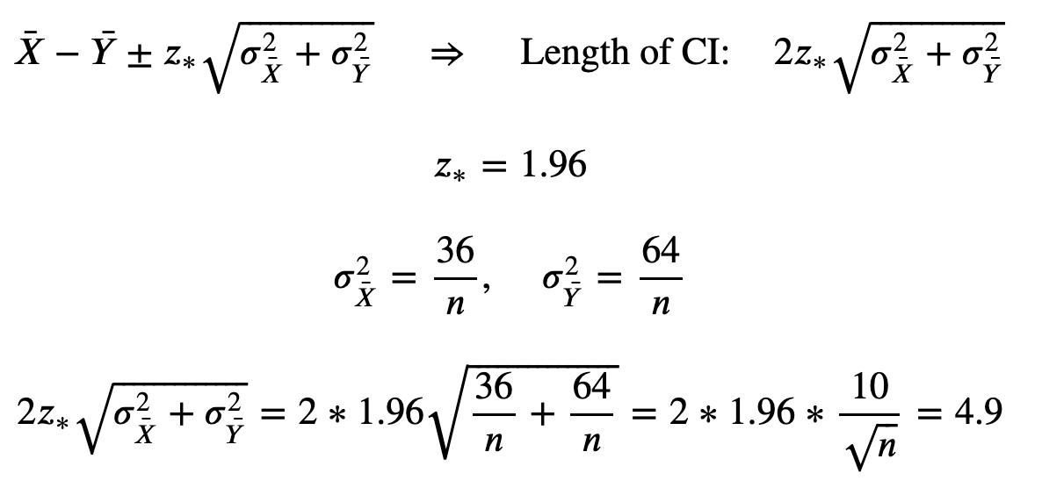

Slide 7


Slide 9
